Slide 1
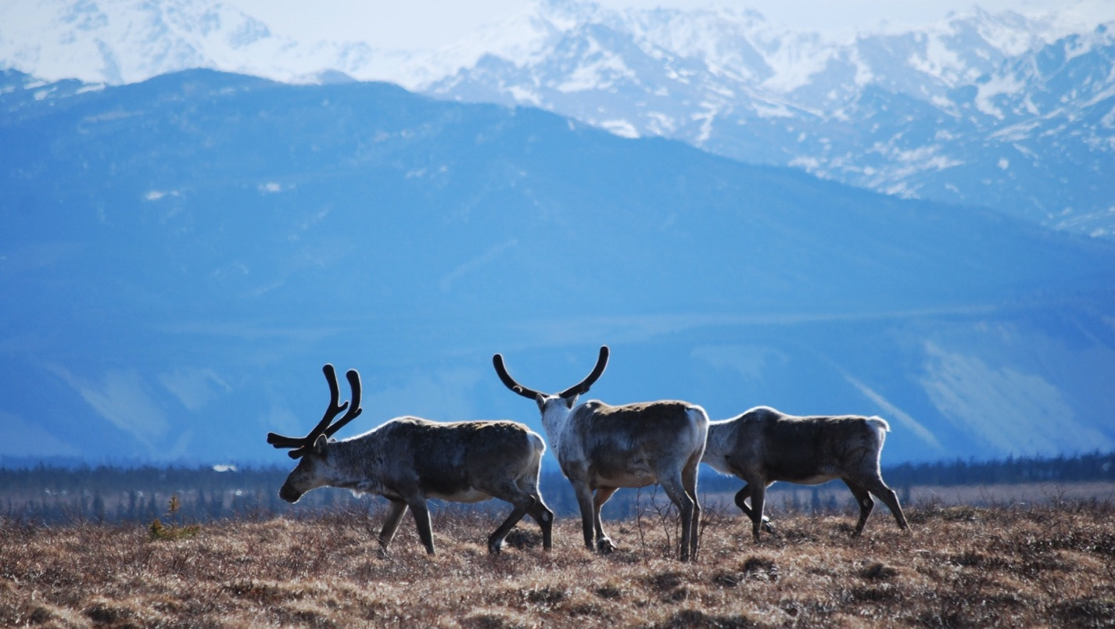
Arctic Boreal Vulnerability Experiment (ABoVE)
2019 ABoVE Airborne Flights
14 July 2019 (DOY 195)
AVIRIS-NG: Scotty Creek – Fort Liard
Charles Miller, Deputy Science Lead
Jet Propulsion Laboratory, California Institute of Technology
and the ABoVE Science Team For Hank Margolis, Mike Falkowski, Bruce Tagg, Jack Kaye
NASA HQ
2019

Slide 2
14 July 2019/DOY 195 Scotty Creek – Fort Liard
Daily Status:
AVIRIS-NG / Dynamic Aviation B-200 (N53W)
REPORT DATE: 14 July 2019
Current Status of Aircraft: GREEN
Current Status of AVIRIS: GREEN
Current Deployment Location: Yellowknife NT (CYZF)
Crew: M Drowley (PIC), C McCann, M Helmlinger, J Chapman
Science Planning: A Thorpe
Data Processing: W Olsen-Duvall
Instrument Manager: M Eastwood
Instrument PI: R Green
Science Lead: C Miller

Slide 3
14 July 2019/DOY 195 Scotty Creek – Fort Liard
Daily Summary:
Mostly clear with some high cirrus
Flew Scotty Creek grid then proceeded to Fort Liard grid
Long transects acquired during transits

Slide 4
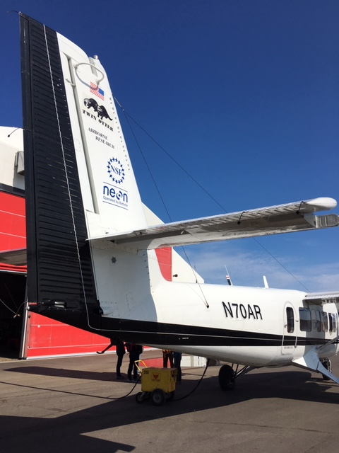
14 July 2019/DOY 195 Scotty Creek – Fort Liard
Update
Notes:
AVIRIS & NEON teams in Barrow

Slide 5
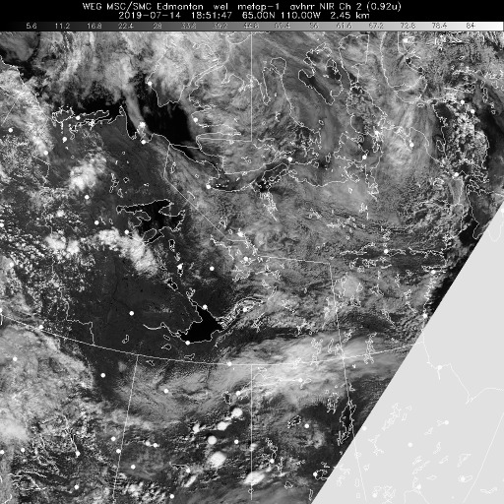
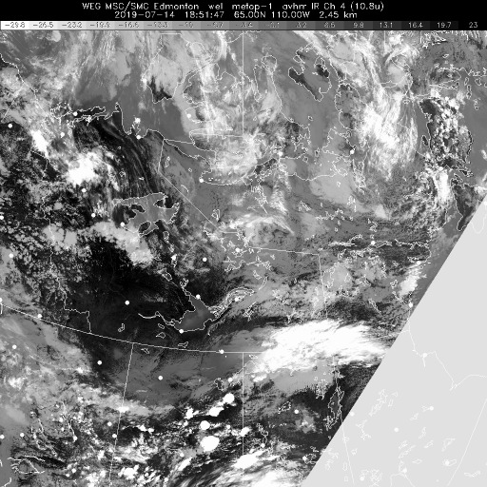
14 July 2019/DOY 195 Scotty Creek – Fort Liard
Vis 1851Z
IR 1851Z
Notes:
Clear cell over the Scotty Creek – Fort Liard area

Slide 6
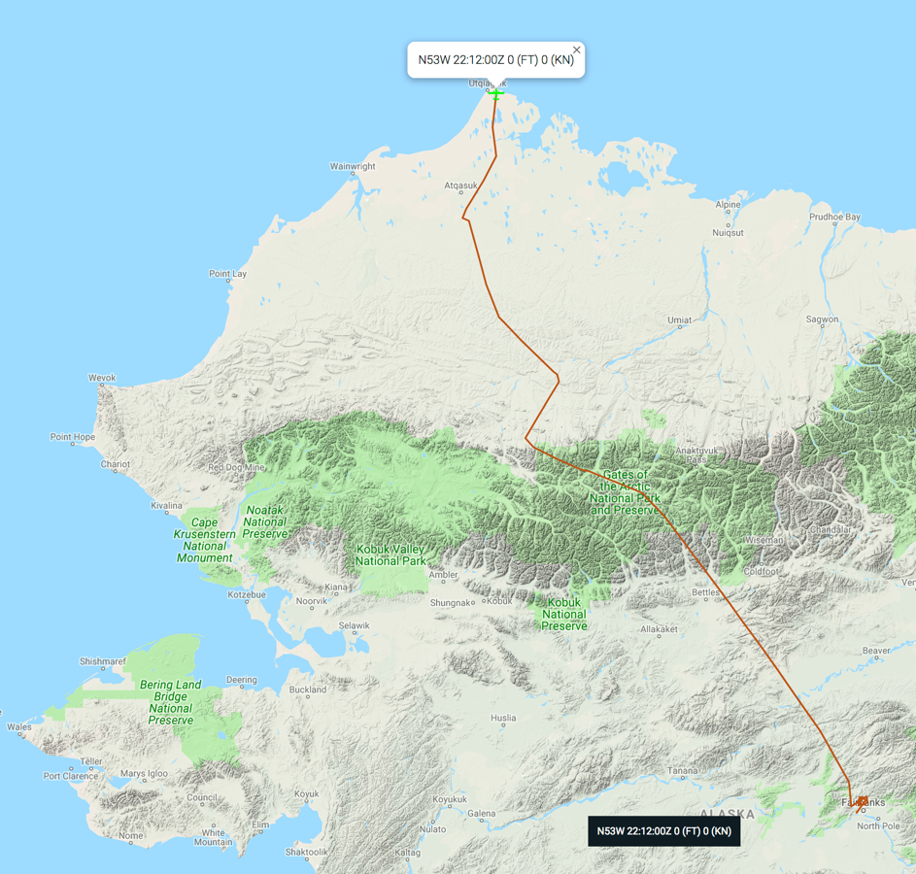
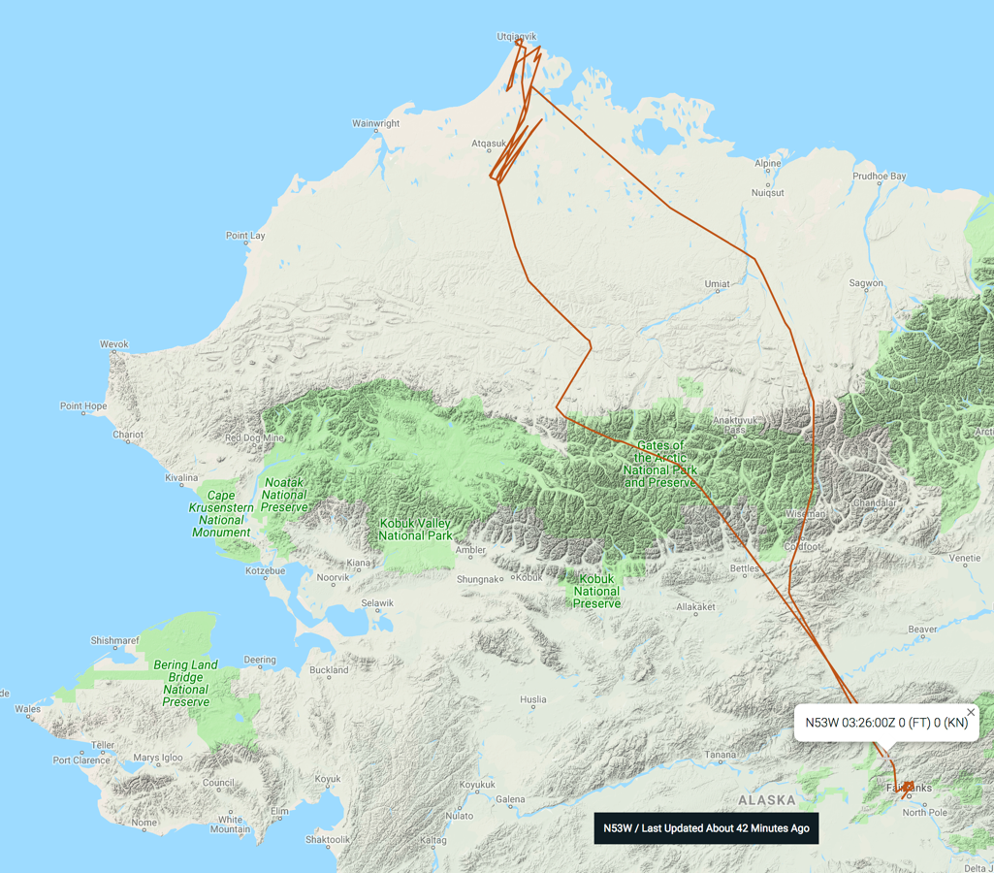
14 July 2019/DOY 195 Scotty Creek – Fort Liard
Leg 1
Leg 2
Update
As-Flown Lines

Slide 7
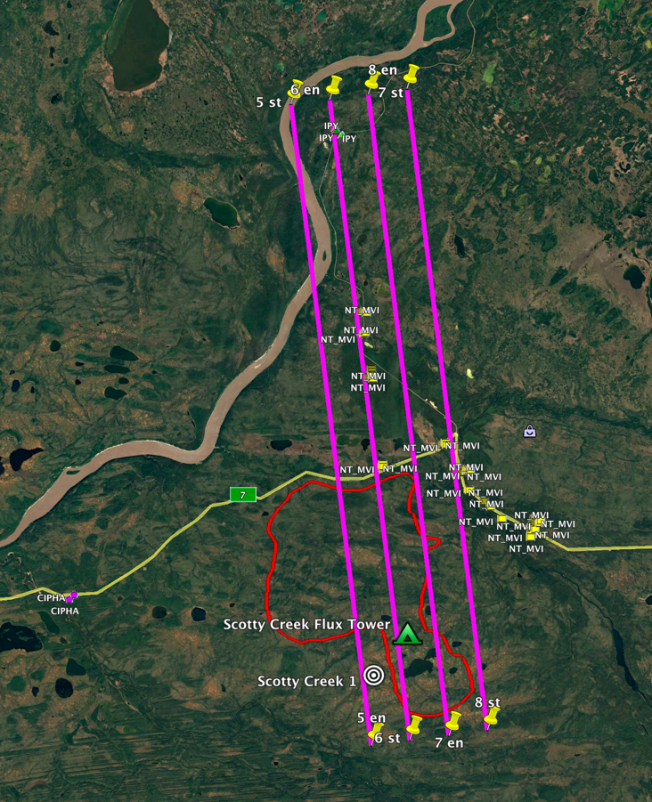
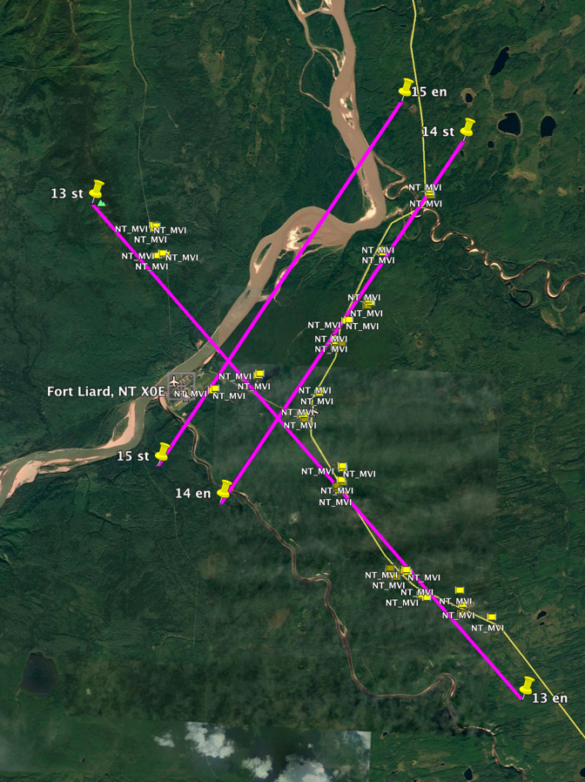
14 July 2019/DOY 195 Scotty Creek – Fort Liard
Scotty Creek NT
Planned Flight Lines
Fort Liard NT
Planned Flight Lines

Slide 8
14 July 2019/DOY 195 Scotty Creek – Fort Liard
AVIRIS-NG Quick-look products
https://avirisng.jpl.nasa.gov/cgi/flights.cgi?step=view_flightlog&flight_id=ang20180721t
A. Line 325A-D, FL183, Run ID 183446: Chalkyitsik – Porcupine River
B. Line 325A-D, FL183, Run ID 201426 : Chalkyitsik – Porcupine River - reverse
A
Update
B
A. A bit of fogging on lower edge of image
B. Popcorn clouds and orthorectification glitch near left edge

Slide 9
Backup

Slide 10
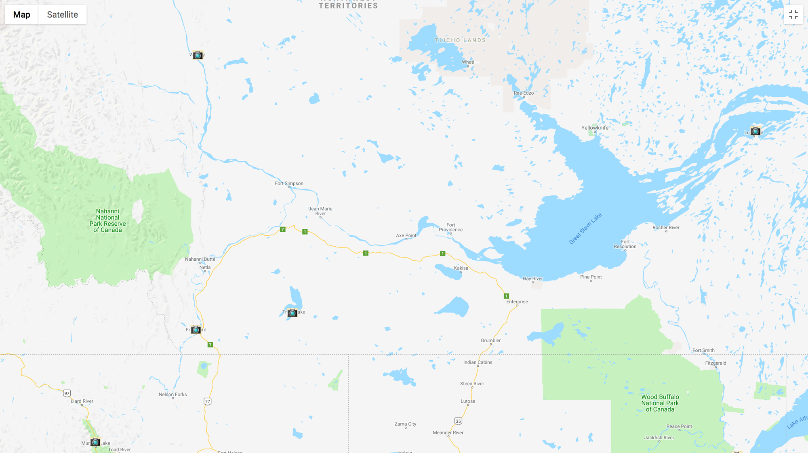
Camera Locations
Wrigley
Trout
Lake
Fort
Liard

Slide 11
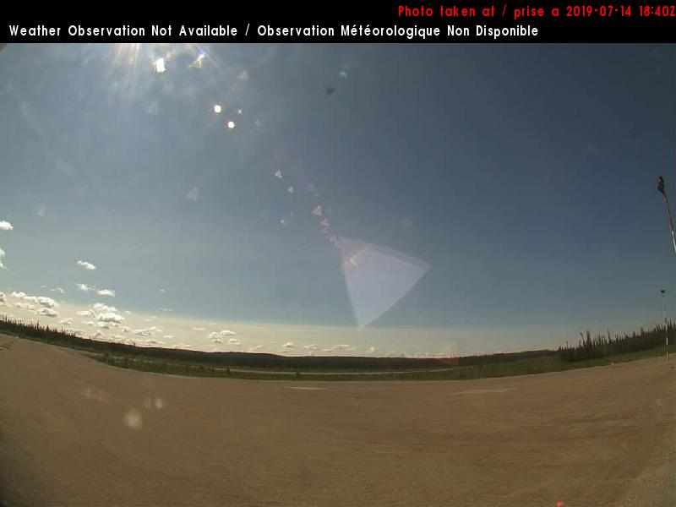
14 July 2019/DOY 195 Scotty Creek – Fort Liard
Trout Lake / Sambaa K'e Airport (CEU9) N60 25 25 W121 16 11
1420 MDT/1920 UTC
East
South
Notes:
Taken around the time of data acquisition over Scotty Creek

Slide 12
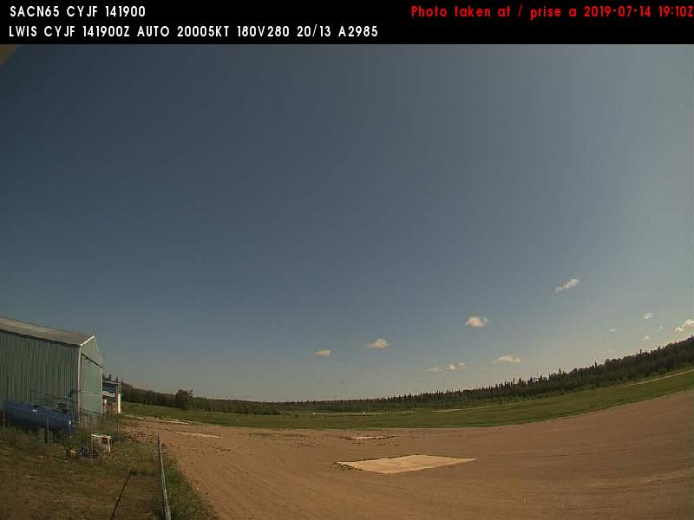
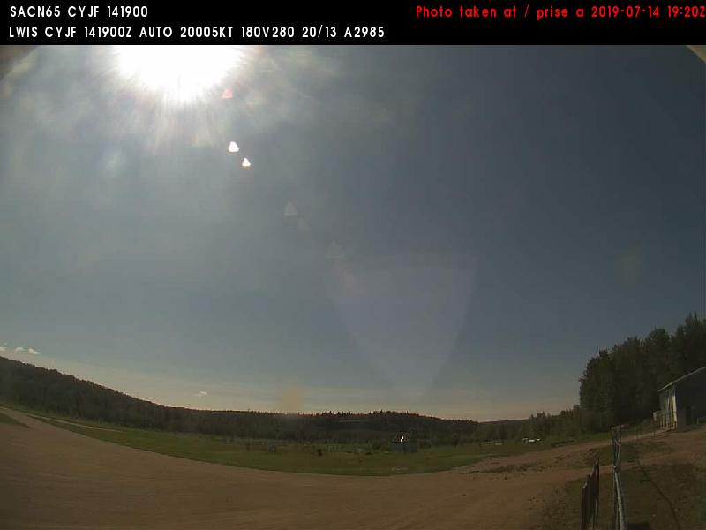
14 July 2019/DOY 195 Scotty Creek – Fort Liard
Fort Liard (CYJF) N60 14 08 W123 28 12 Elev: ' MSL
1420 MDT/1920 UTC
East
East
Southeast
Notes:
Taken about the time of AVIRIS data acquisition over Fort Liard

Slide 13
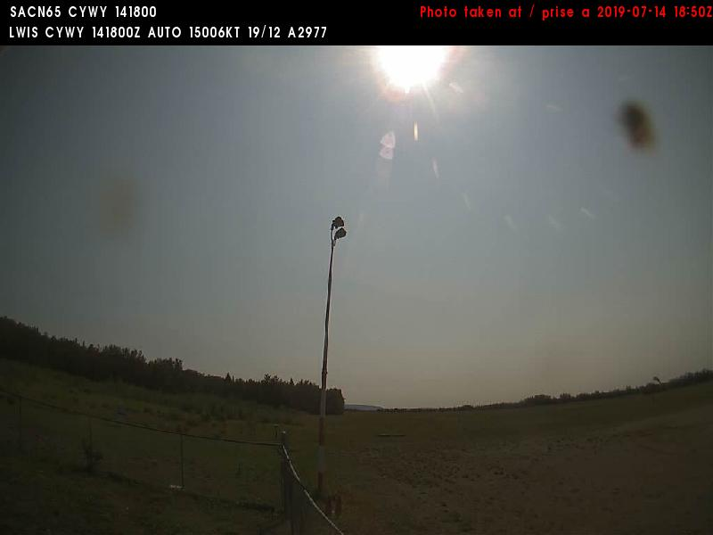
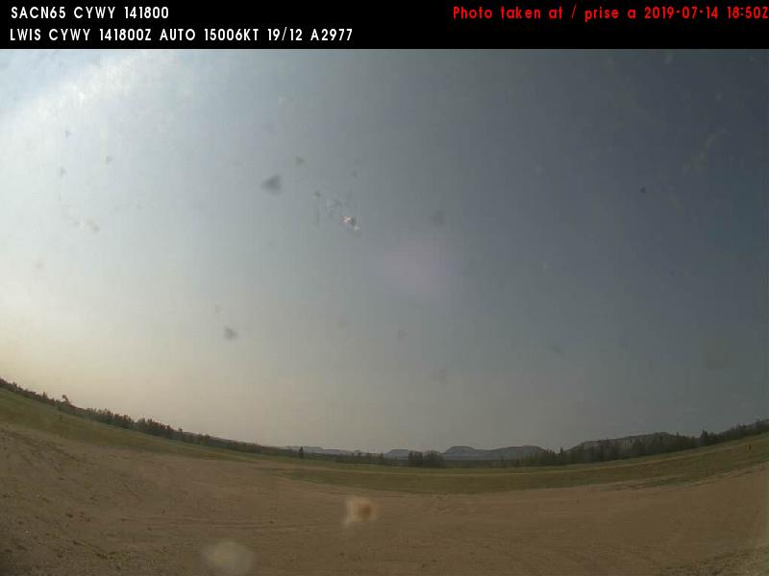
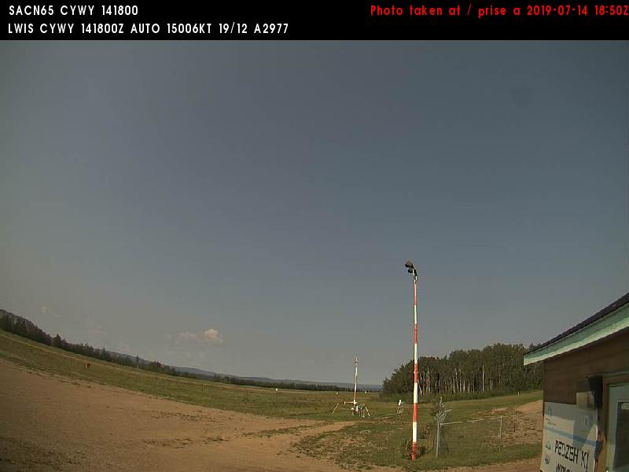
14 July 2019/DOY 195 Scotty Creek – Fort Liard
Wrigley Airport (CYWY) N63 12 35 W123 26 12
1420 MDT/1920 UTC
East
Southeast
Southwest
Northwest

